Slide 1

Unit 2 Lesson 6 Earthquakes
Florida Benchmarks
SC.7.N.1.1 Define a problem from the seventh grade curriculum, use appropriate reference materials to support scientific understanding, plan and carry out scientific investigations of various types, such as systematic observations or experiments, identify variables, collect and organize data, interpret data in charts, tables, and graphics, analyze information, make predictions, and defend conclusions.
Copyright © Houghton Mifflin Harcourt Publishing Company

Slide 2
Unit 2 Lesson 6 Earthquakes
Florida Benchmarks
SC.7.E.6.5 Explore the scientific theory of plate tectonics by describing how the movement of Earth’s crustal plates causes both slow and rapid changes in Earth’s surface, including volcanic eruptions, earthquakes, and mountain building.
SC.7.E.6.7 Recognize that heat flow and movement of material within Earth causes earthquakes and volcanic eruptions, and creates mountains and ocean basins.
Copyright © Houghton Mifflin Harcourt Publishing Company

Slide 3
Unit 2 Lesson 6 Earthquakes
Florida Benchmarks
LA.7.4.2.2 The student will record information (e.g., observations, notes, lists, charts, legends) related to a topic, including visual aids to organize and record information, as appropriate, and attribute sources of information.
Copyright © Houghton Mifflin Harcourt Publishing Company

Slide 4
Unit 2 Lesson 6 Earthquakes
Let’s Focus
What is an earthquake?
Earthquakes are ground movements that occur when blocks of rock in Earth move suddenly and release energy.
The energy is released as seismic waves that cause the ground to move.
Copyright © Houghton Mifflin Harcourt Publishing Company

Slide 5
Unit 2 Lesson 6 Earthquakes
What is an earthquake?
The place within Earth where the first motion occurs is called the focus.
The place on Earth’s surface above the focus is called the epicenter.
Copyright © Houghton Mifflin Harcourt Publishing Company

Slide 6
Unit 2 Lesson 6 Earthquakes
What causes earthquakes?
Most earthquakes occur near a tectonic plate boundary, which is where two or more tectonic plates meet.
The movement of tectonic plates breaks Earth’s crust into a series of faults, which are breaks in Earth’s crust along which blocks of rocks move.
The release of energy that accompanies the movement of rock along a fault is what causes an earthquake.
Copyright © Houghton Mifflin Harcourt Publishing Company

Slide 7
Unit 2 Lesson 6 Earthquakes
What causes earthquakes?
Stress causes deformation, which is the process by which rock changes shape.
As stress on rock increases, the energy stored in it increases.
When the stress is released, the rock sometimes returns to its original shape.
Copyright © Houghton Mifflin Harcourt Publishing Company

Slide 8
Unit 2 Lesson 6 Earthquakes
What causes earthquakes?
Deformation in which rock can spring back to its original shape is called elastic deformation.
The return of rock to its original shape after elastic deformation is called elastic rebound.
Copyright © Houghton Mifflin Harcourt Publishing Company

Slide 9
Unit 2 Lesson 6 Earthquakes
Unstable Ground
Where do earthquakes happen?
Most earthquakes happen at or near tectonic plate boundaries.
At tectonic plate boundaries, stress builds up from tectonic plates colliding, separating, or grinding past each other.
Copyright © Houghton Mifflin Harcourt Publishing Company

Slide 10
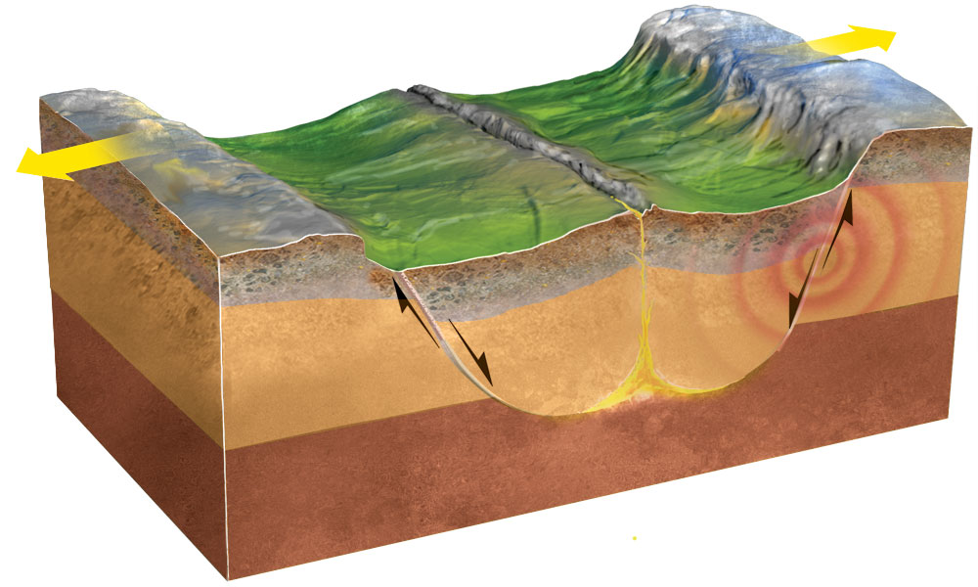
Unit 2 Lesson 6 Earthquakes
Where do earthquakes happen?
At divergent boundaries, tension stress causes normal faults to form. Earthquakes tend to be shallow because the crust is thin.
Copyright © Houghton Mifflin Harcourt Publishing Company

Slide 11
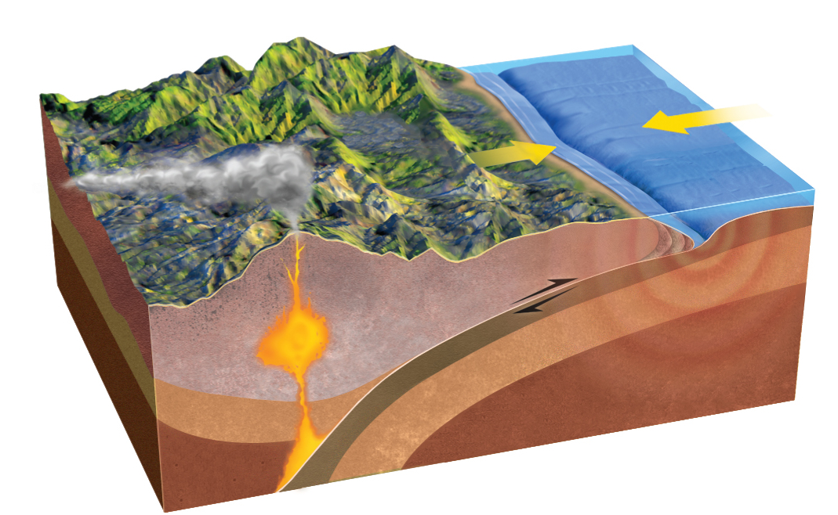
Unit 2 Lesson 6 Earthquakes
Where do earthquakes happen?
At convergent boundaries, rock is squeezed, causing reverse faults to form. Earthquakes can be very strong and deep.
Copyright © Houghton Mifflin Harcourt Publishing Company

Slide 12
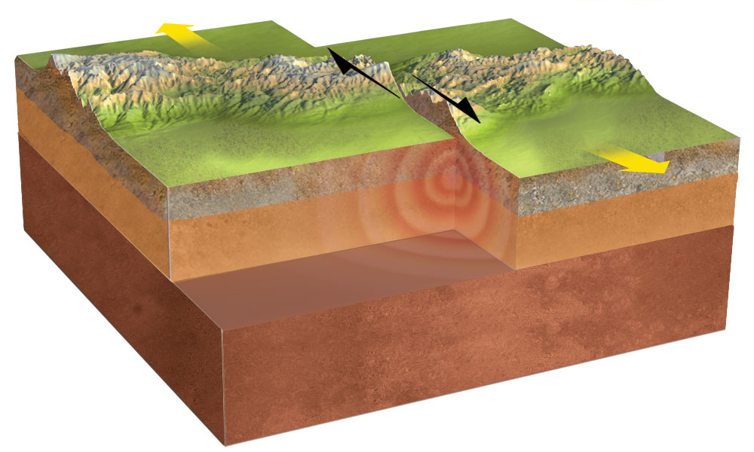
Unit 2 Lesson 6 Earthquakes
Where do earthquakes happen?
At transform boundaries, shear stress pushes tectonic plates in opposite directions. Earthquakes tend to be relatively shallow.
Copyright © Houghton Mifflin Harcourt Publishing Company

Slide 13
Unit 2 Lesson 6 Earthquakes
What are some effects of earthquakes?
Most earthquakes do not cause damage, but some strong earthquakes can cause major damage and loss of life, especially in areas closest to the epicenter.
When the shaking of an earthquake is more than structures can withstand, major destruction can occur.
Much of the injury and loss of life after an earthquake is caused by structures that collapse.
Copyright © Houghton Mifflin Harcourt Publishing Company

Slide 14
Unit 2 Lesson 6 Earthquakes
What are some effects of earthquakes?
An earthquake under the ocean can cause a vertical movement of the sea floor that displaces an enormous amount of water. This can generate a tsunami.
A tsunami is a series of extremely long waves that can travel across the ocean at speeds of up to
800 km/h.
As the waves reach the shoreline, the height of the waves increases. The huge waves can cause major destruction.
Copyright © Houghton Mifflin Harcourt Publishing Company

Slide 15
Unit 2 Lesson 6 Earthquakes
Killer Quake
In 2004, an earthquake generated a tsunami that wiped out half the population in Banda Aceh, Indonesia.
The tsunami traveled outward from the epicenter in the Indian Ocean. Banda Aceh was very close to the epicenter.
The tsunami affected coastal areas around the entire Indian Ocean, even reshaping many coastlines in Asia.
Copyright © Houghton Mifflin Harcourt Publishing Company

